Slide 1

Effects of Monetary Policy on GDP using BVAR,SVAR and BSVAR
Name:
Abhijith
Vidhi Sharma

Slide 2
Contents
No. | Topics
1 | Introduction to Bayesian VAR and priors used
2 | Bayesian VAR model with Minnesota prior
3 | SVAR (Structural Vector Autoregression Model)
4 | Uhlig Restriction Model
5 | Benefits of using Bayesian

Slide 3
The Problem
Outcome: To observe causal effects of monetary policy shocks on GDP
General Equilibrium
How are we going to model DSGE ?
Identification Problem with Vector Auto Regression
What are confounds and Lags in here
How to overcome these challenges

Slide 4
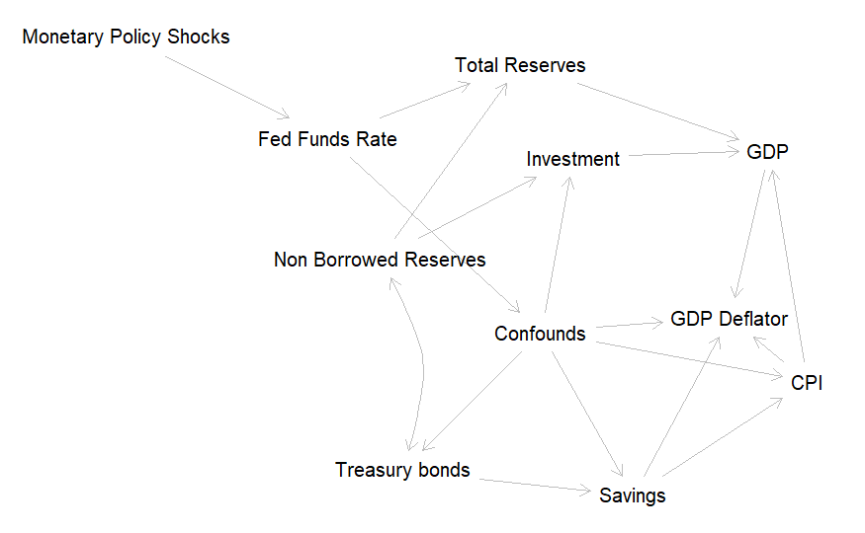

Slide 5
Introduction to the world of Bayesian VAR
Gibbs sampler
Joint distribution is unknown but conditional distribution of each variable is known.
Iterations repeated (n-1) times, alternating between conditional probability distribution of X and Conditional probability distribution of Y.
Gibbs Sampling to approximate the posterior distribution.
The conditional probabilities are normal distributions, function of mu and sigma

Slide 6
Introduction to the world of Bayesian VAR
Normal-inverse-Wishart Prior
Prior for variance and covariance matrix
Minnesota Prior
Have one or more J*J Matrices of autoregressive parameters in a Var Model, user specifies two tuning hyperparameters for prior: theta and lambda.
Specify prior covariance for Var autoregressive parameters
Prior means are set to 0 or 1, in our model, set up as identity matrix (1,1,1).

Slide 7
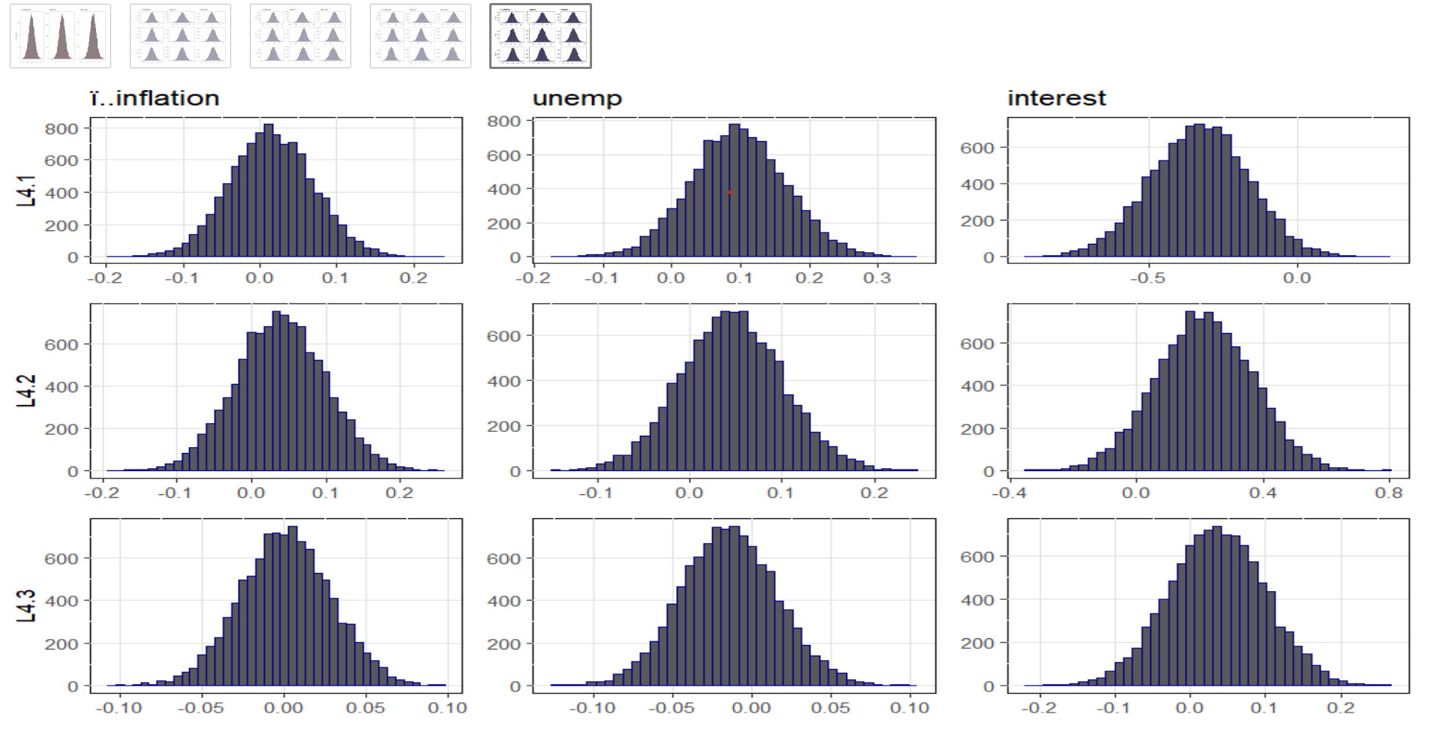
Bayesian VAR model with Minnesota prior

Slide 8
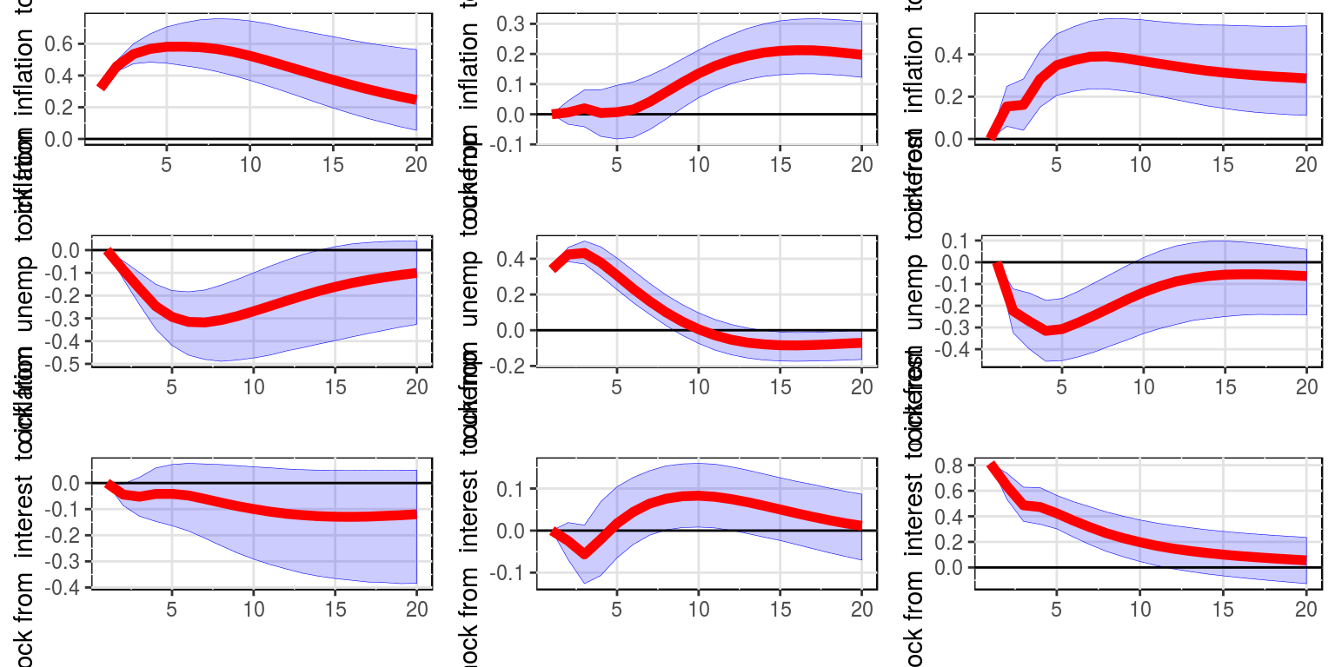
Impulse Response Function for inflation, unemployment and interest rate

Slide 9
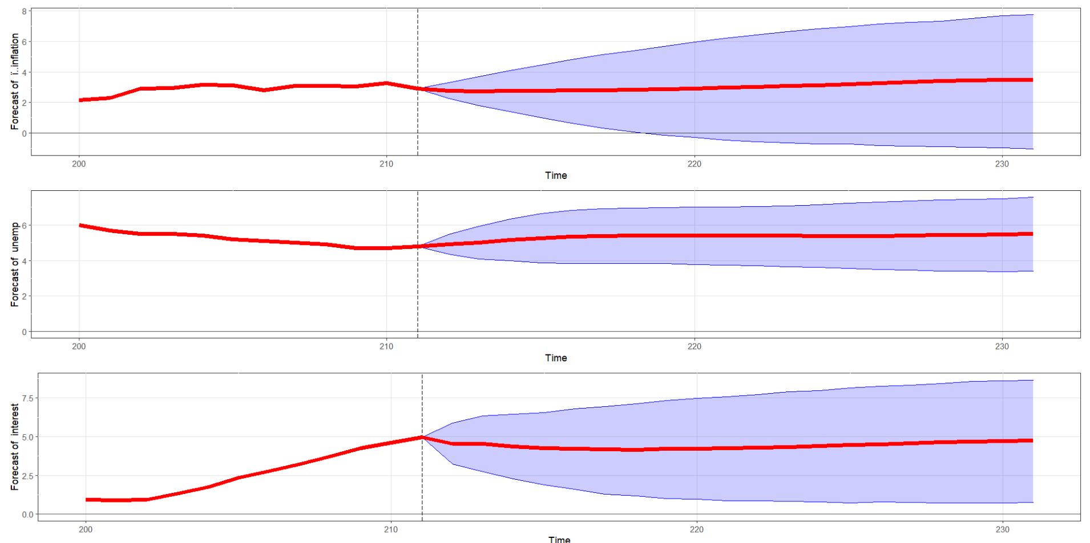
Forecasting using BVAR

Slide 10
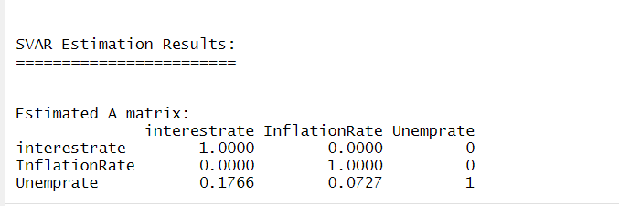
SVAR- Structural Vector Autoregression Model
With restriction on
Unemployment rate and Interest rate- kept as NA and followed Amat restriction
Unemployment rate and Inflation rate-kept as NA and followed Amat restriction

Slide 11
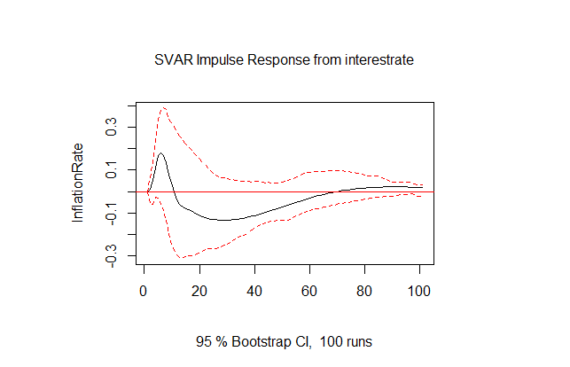
SVAR- Impulse Response Function

Slide 12
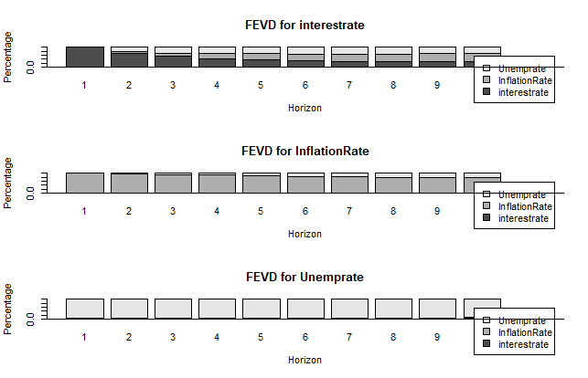
Forecasting Error Variance Decomposition

Slide 13

How to solve a puzzle?

Slide 14
Sign Restrictions
As mentioned on Uhlig 2005 paper : For monetary tightening shock
Fourth variable: do not decrease the FED’s policy rate for x months after the shock
Third variable: do not increase commodity prices for x months after the shock
Second variable: do not increase inflation for x months after the shock
Fifth variable: do not increase non-borrowed reserves for x months after the shock

Slide 15
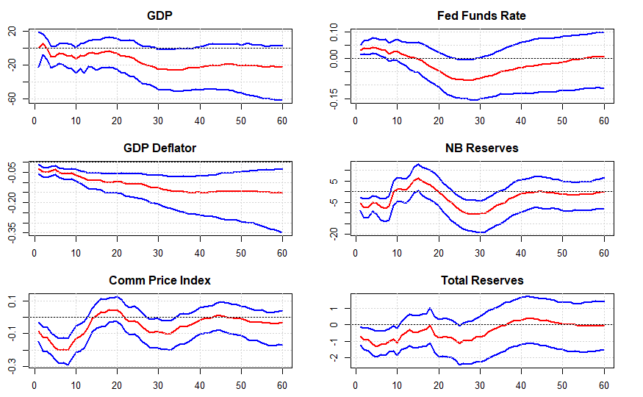
IRF Uhlig

Slide 16
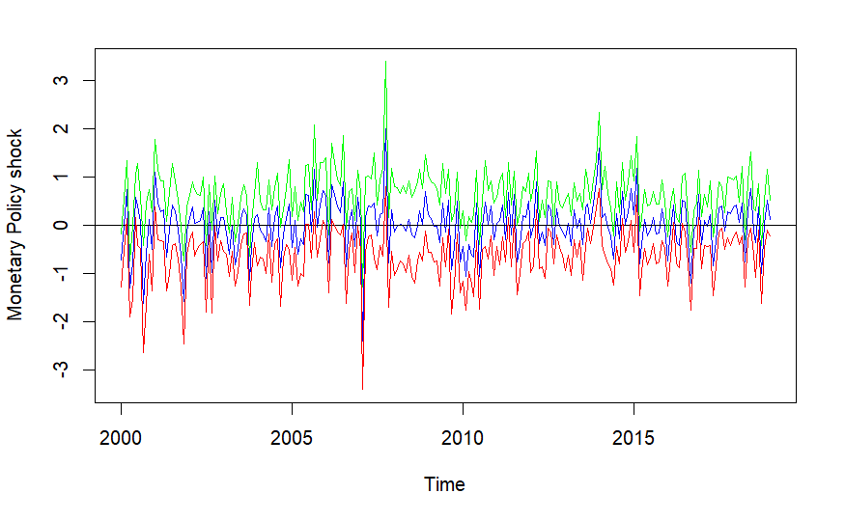
Shocks

Slide 17
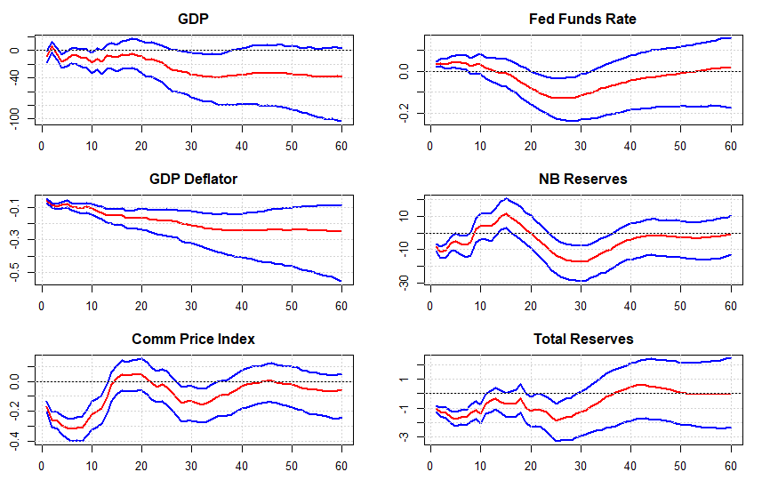
Additional Restrictions

Slide 18
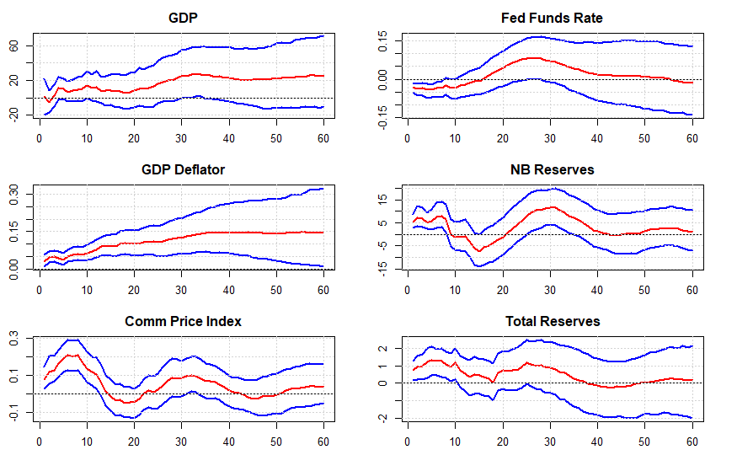
Expansionary Monetary Policy

Slide 19
Benefits of using Bayesian
BVAR model overcomes the problem of short time series data by using prior statistical information.
Overcome the issue of too little freedom-introducing statistical properties in traditional model.
Make in-sample fitting less dramatic and improve out-of-sample performance.
Scientific method that can be evaluated on its own, without reference to the forecaster running the model.
Generates not only a forecast but a complete, multivariate probability distribution for future outcomes of the economy that appears to be more realistic.

Slide 20

Any questions?

